Slide 1
Meet the Teacher Night
CC1
Ms. Karnia
Tuesday, September 10, 2024

Slide 2
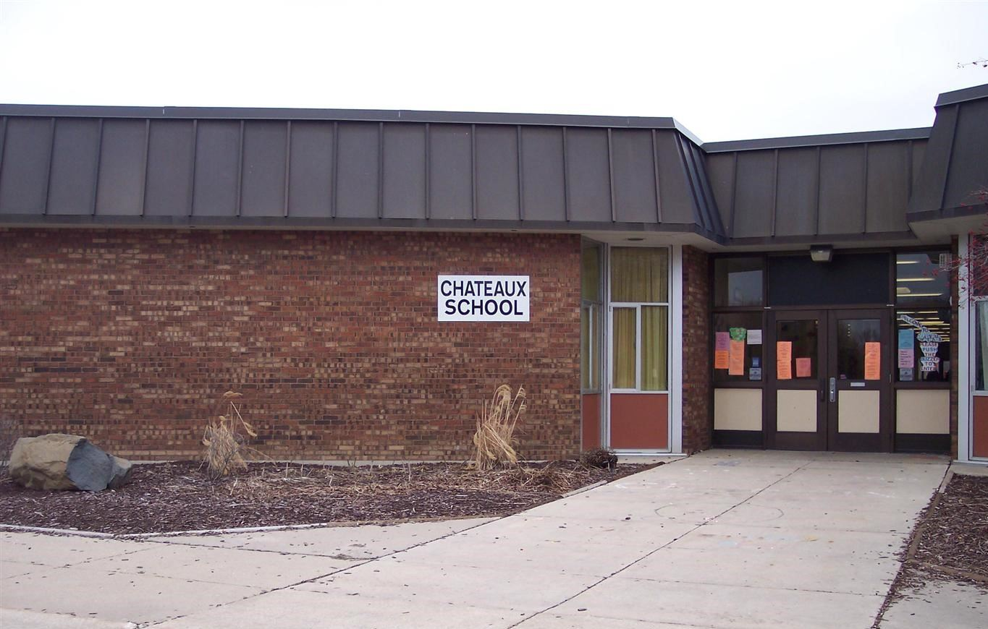
Welcome to Chateaux
Principal: Mr. J. Bywater
Administrative Assistant: Ms. Hicks-Harris
3600 Chambord Lane, Hazel Crest, IL
708-335-9776

Slide 3
Welcome to CC1
Ms. Karnia, teacher
Ms. Arianoutsos, paraprofessional
Combination class of kindergarteners, first graders, and second graders

Slide 4
All About Us
Ms. Karnia: I am starting my 19th year as a teacher in Prairie-Hills Elementary School District 144 and 16th year at Chateaux. Over my tenor, I have taught Early Childhood (Pre-K) Special Education and Self-contained classrooms with Kindergarten, First, Second and Third Grades.
Mrs. Arianoutsos: Paraprofessional in the district in special education classrooms for over 24 years. This is her 11th year at Chateaux working with me.

Slide 5
Class Schedule
8:20-8:45: Arrival/Breakfast
8:45-8:55: Bathroom
8:55-9:15: Social Emotional Learning
9:15-10:35: Math
10:35-10:45: Heggerty (Phonics Work)
10:45-11:15: Community Intervention Period
11:15-12:00 Lunch/Bathroom

Slide 6
Class Schedule cont...
12:00-12:30: Quiet Time/Recess
12:30-12:45: DEAR (Drop Everything and Read)
12:45-1:50: Reading/Writing
1:50-2:20: I-Ready
(T: Social Language Group Th: Media/Library 1:55-2:25)
2:25-2:55: Specials (M & W: Music T & Th: PE (wear gym shoes))
2:55: Dismissal

Slide 7
On Friday
We will be doing social studies during math time and science during reading time.
We will incorporate art time, fine motor time and social practice time.
We will have PBIS time on Friday during specials time, which may include a movie and snack or
free time.

Slide 8
Arrival/Dismissal Expectations
Arrival
Breakfast served between 8:25-8:40
Doors close at 8:45
Arrival after 8:45 is considered tardy (unless bus is late)
Dismissal
2:55 for both bus and parent picked up students

Slide 9
Early Dismissals and Non-Attendance Days
SIP Days: 11:45 Dismissal (our class will dismiss at 11:35):
October 25 January 25 February 28 May 23
Records Days: 1:30 Dismissal (our class will dismiss at 1:20):
November 1 January 17 March 14 May 16
Student Non-Attendance Days:
October 14 (Indigenous People’s Day) November 5 (Election Day) November 11 (Veteran’s Day) November 27 (Parent Teacher Conferences) November 28 & 29 (Thanksgiving) December 23-January 6 (Winter Break) January 20 (MLK Day) February 17 (Presidents’ Day) March 3 (Pulaski Day) March 28 (Parent Teacher Conferences) April 18-April 25 (Spring Break) May 26 (Memorial Day)

Slide 10
Attendance
Consistent attendance is important for students to keep routine and engaged in learning.
However, if you student is sick
Please keep sick students at home
Call office when absent
If student has a doctors or dentist appointment, bring the note to school

Slide 11
Classroom Expectations
Be Responsible: Come to school, complete school work, complete homework
Be Respectful: Use kind words to everyone, listen and follow teacher directions
Be Safe: Walk while in school, keep hands and feet to yourself, use class furniture appropriately

Slide 12
Classroom Behavior Management System
When redirecting student behaviors, student’s disabilities will be kept in consideration.
Silver: Excellent day; student made choices above and beyond everyday expectations. Student will receive positive praise or rewards.
Green: Good day; student made positive choices and met expectations. Student will receive positive praise or rewards.
Yellow: Ok day; student made some choices that required multiple reminders and redirections of expectations; Student made need to spend time away from group.
Orange: Rough day; student made choices that could not be redirected or occurred many times throughout the day. Student may need to spent time alone, loss of privilege and/or a note home.
Red: Really rough day; student’s behavior was unable to be redirected. Student may need to be removed from the classroom, loss of privilege, and/or a phone call home.

Slide 13
Food Information
Students are served both breakfast and lunch at school.
At lunch, the students will be given a choice between a hot and cold option.
Students are welcome to bring in breakfast, lunch and snacks if you prefer.
Breakfast/Lunch menus will be sent home monthly. Please review and feel free to send a lunch/snack on days you know your child will not enjoy the lunch served.
Please let me know all food allergies as soon as possible.
District 144 is a peanut/nut free school district. Please refrain from sending anything with peanuts, nuts or peanut butter to school with your student. We do have allergies in the classroom.

Slide 14
Homework
Homework is meant to give your student practice.
It will never be more than 10-20 minutes per night.
One math sheet and letter, sight words, and/or spelling practice.

Slide 15
Lit in the Hills
IPADs will be sent home for students to use on My Reading Academy.
We are asking the students spend 45 minutes a week on My Reading Academy.

Slide 16
Special Education Information
Services
Students will be seen by speech-language pathologist, social worker, occupational therapist and physical therapist according to minutes on IEP.
Services may be done individually or in a group, depends on student needs
Ms. Green, social worker
?????, speech-language pathologist
Ms. Yates, occupational therapist
Ms. Sue, physical therapist
Ms. Harris, psychologist
IEP Meeting
Meeting will be parent choice (in person or online)
Meetings will be on Thursday
Please let me know as soon as possible if there is a conflict with the time and date of your meeting
Paperwork will emailed to you prior to the meeting for your review
Finalized paperwork will be emailed and sent home with your student
Meetings will be about 30 minutes to an hour

Slide 17
Miscellaneous
School Supplies: The district is providing school supplies for all students, however, you are welcome to send supplies to school if your student has preferences for supplies.
Please check folders each night. Important information and homework assignments will be placed in folder.
Announcements will be sent home in folders, written on behavior logs, and posted on Classroom Dojo.
Please send a change of clothes to school.

Slide 18
Remote Learning
All students will be receiving an IPAD to use at home. This IPAD could be used for remote learning or completing app activities
If we need to go to remote learning, we will be utilizing Google Classroom.
You will have access to Google classroom through your student’s google email account. s11111@phesd144.com with individual password.
I will send individual information on how to get onto the google classroom soon.
Through google classroom you will have access to live learning sessions, classroom assignments and other important information/announcements.
CC1 Superstars 2024-2025 (google.com)

Slide 19
Contact Information
Email
mkarnia@phsd144.net
mkarnia@phesd144.com (gmail account)
Phone
708-335-9776 ex. 2809
Class Dojo (Personalized letters have been sent home)
Follow this link to join our class: Superstars of CC1 (2024-2025)
https://www.classdojo.com/ul/p/addKid?target=class&class=CX22W72

Slide 20
Thank You!!!!!
This presentation will be uploaded to our google classroom under parent resources and our class website found at:
Karnia, Ms. M. / Welcome (phsd144.net)

Slide 21
Let’s have a great year!

